Slide 1
Malls kitchen
Africa’s finest roots

Slide 2
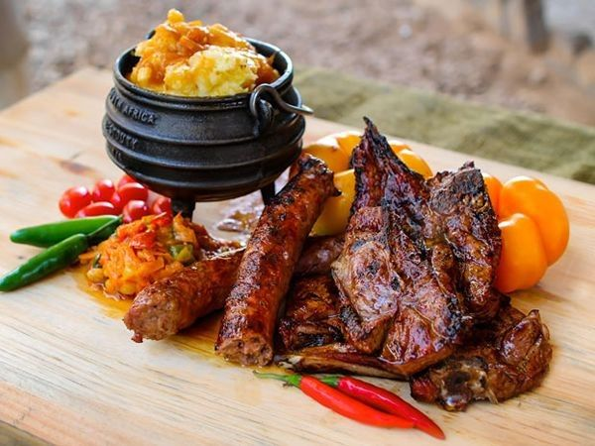
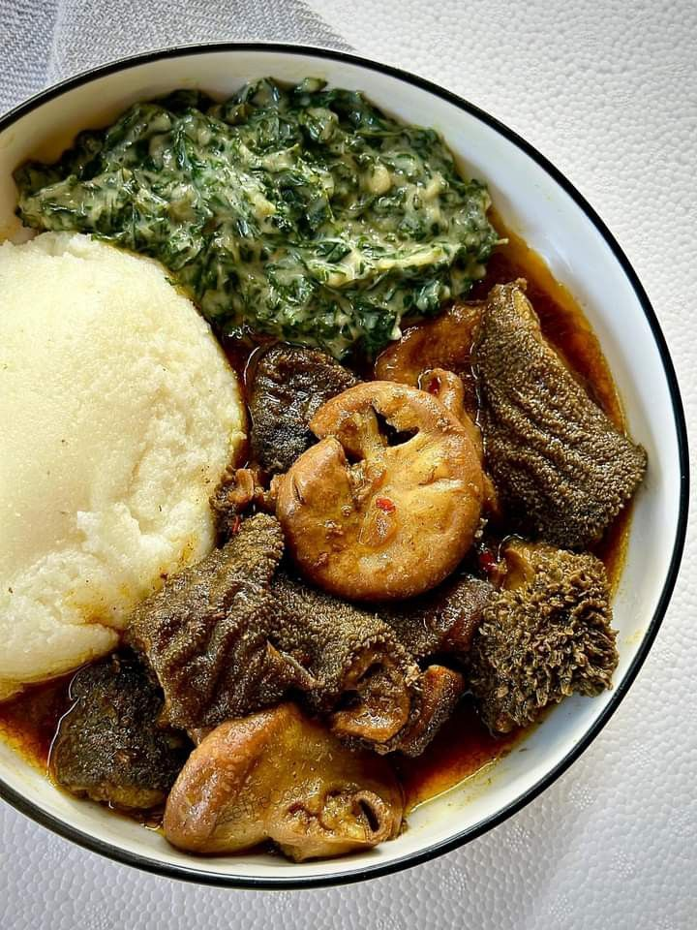
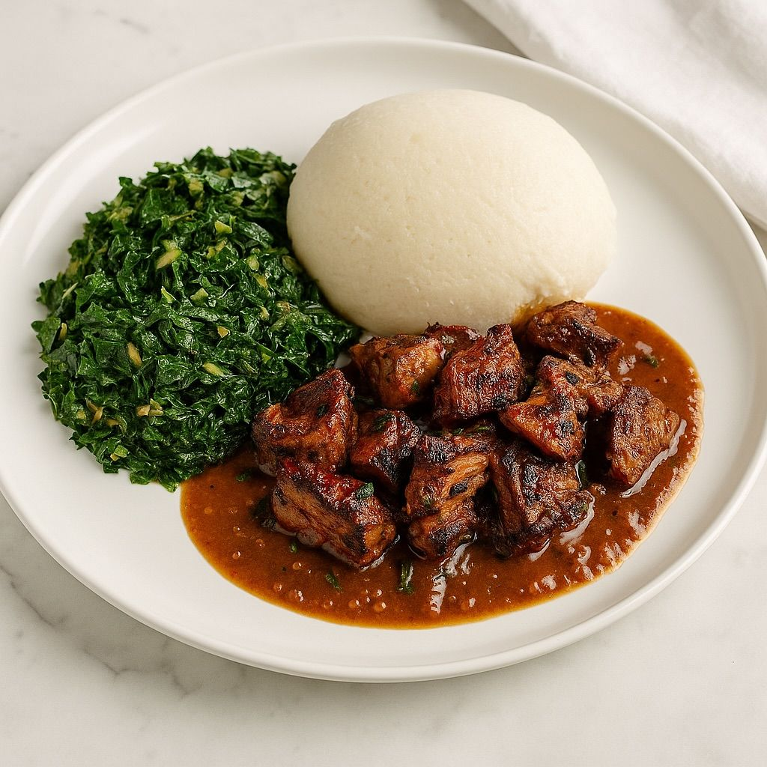
OVERVIEW (signature meals)
Notes:
How and when the business started
Unique elements (signature dishes by name)
Customers(tourist attract)

Slide 3
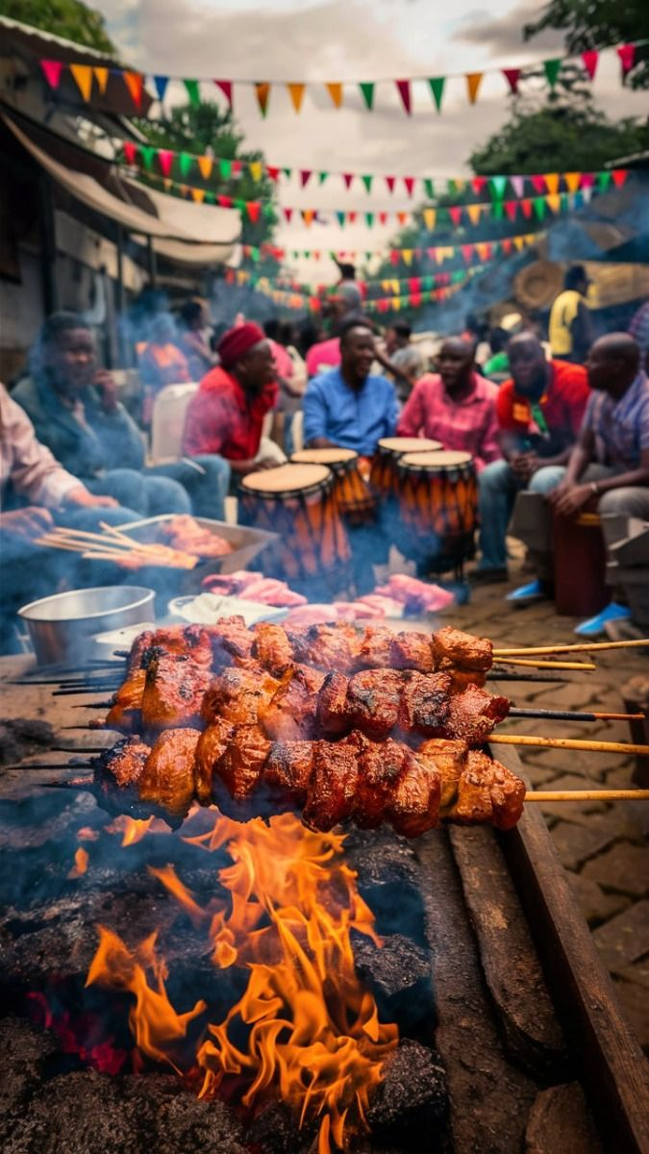
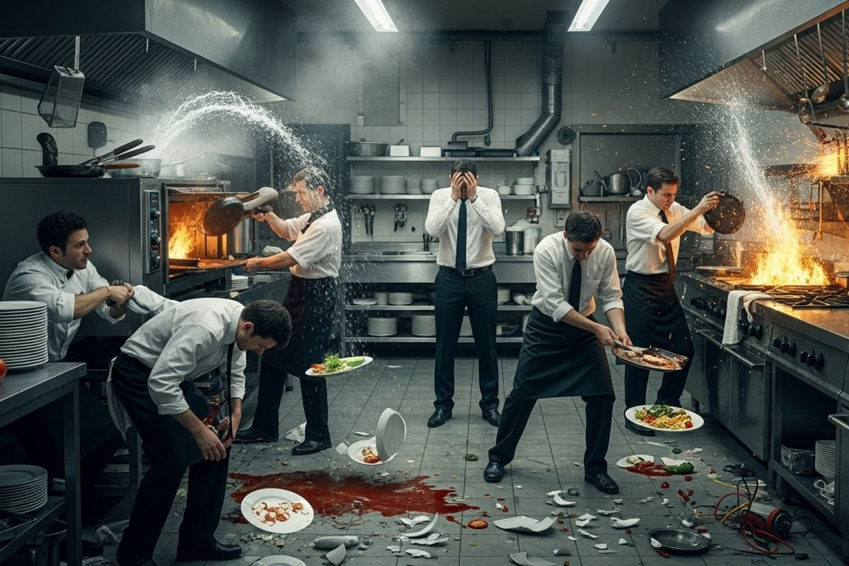
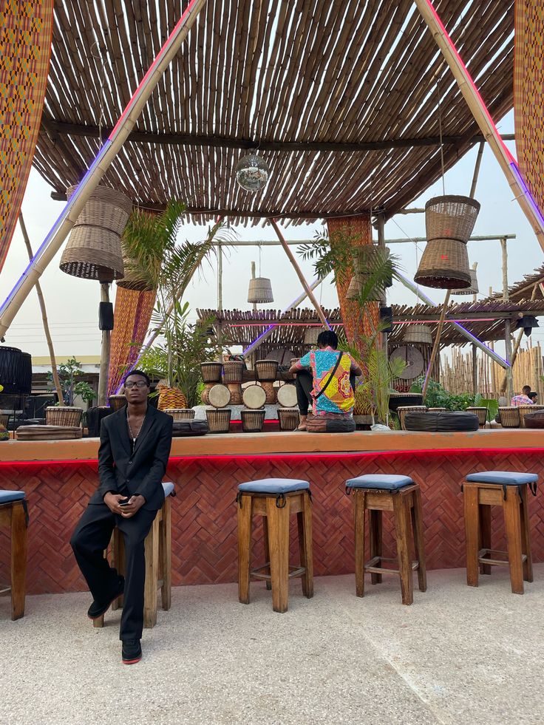
CHALLENGES
Notes:
Restuarant gets over crowded
Chaos in the kitchen orders get mixed up
Many customers are lost due to impaired operating system

Slide 4
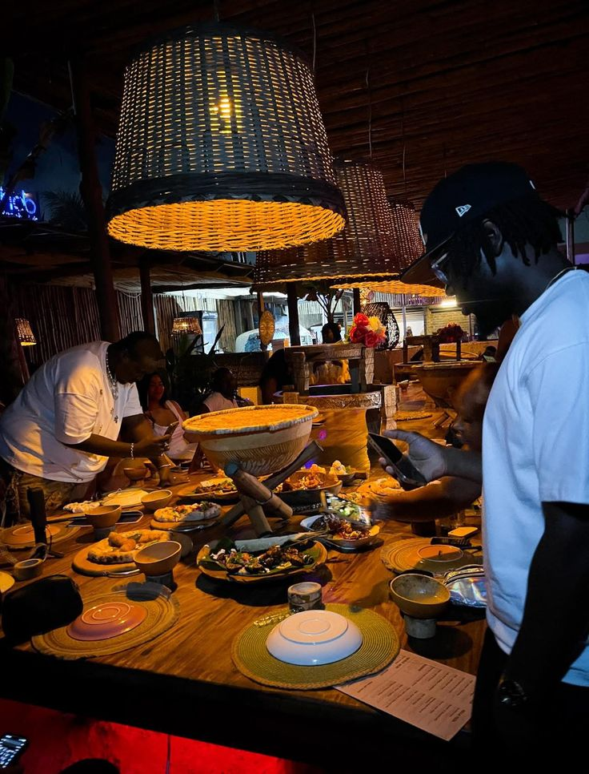
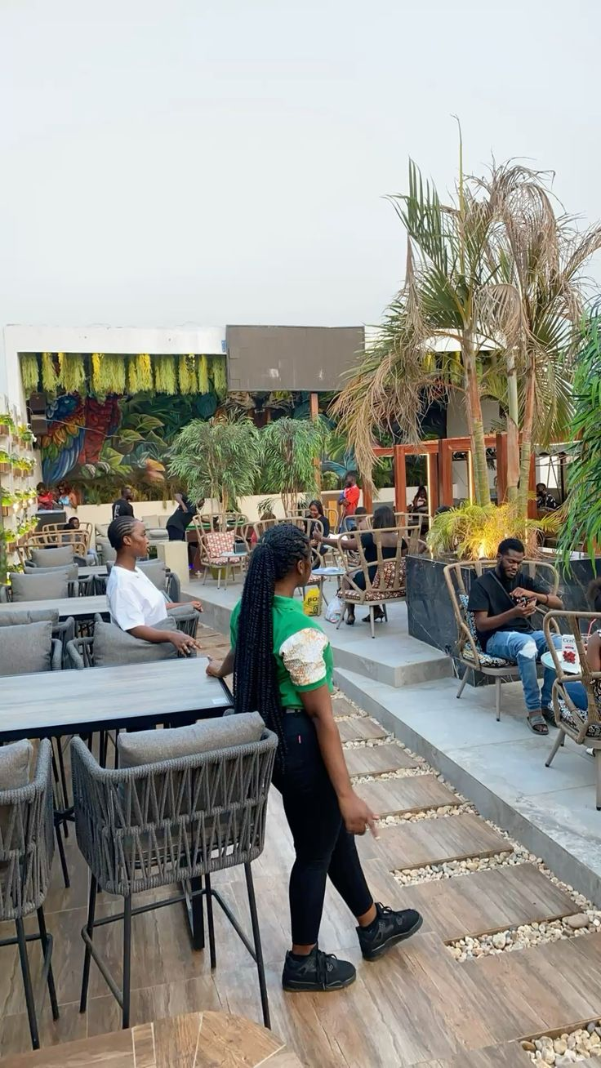


MALLS kitchen with a static website
Notes:
Resturant can operate till late
Orders are delivered smoothly without being mixed up
No chaos in the kitchen
Customers get to enjoy their meal just in time

Slide 5
Benefits of using a static website on AWS
Speed.
Security
Cost-effective:
Easy to deploy
Simple menu management:.
6. Budget-Friendly Hosting
7. Increase our tourist attract custmers

Slide 6
MALLS MIGRATION
( WEBSITE LINK)

